Slide 2
Session 2:
Identifying long-term goals

Slide 5
These are
Short – term goals

Slide 8
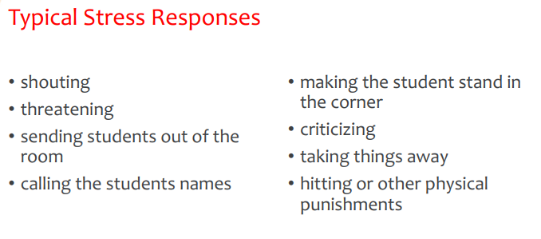

Slide 10
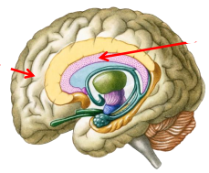

Slide 11
What happens
to children?

Slide 12
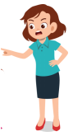

Slide 13
Let’s play
Wheel of furtune

Slide 14
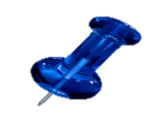
Grade 6
kinder
Grade 1
Dep’t
Spin
Again
Grade 2
Grade 3
AWARD
Grade 4
Grade 5

Slide 15
CHOOSE PLAYER

Slide 16
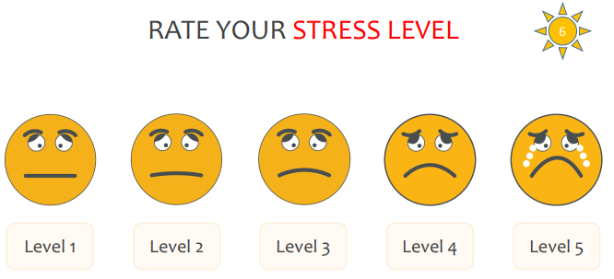

Slide 17
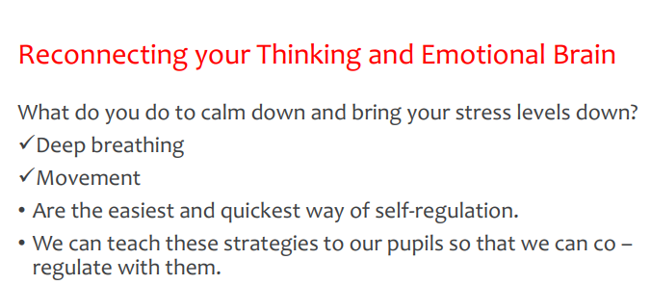

Slide 18
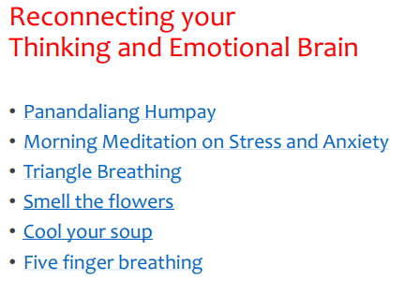

Slide 19
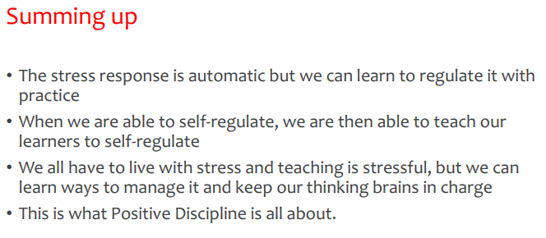

Slide 27
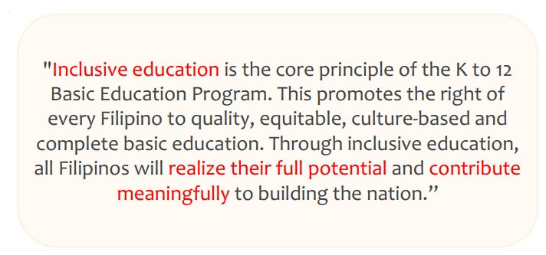

Slide 28
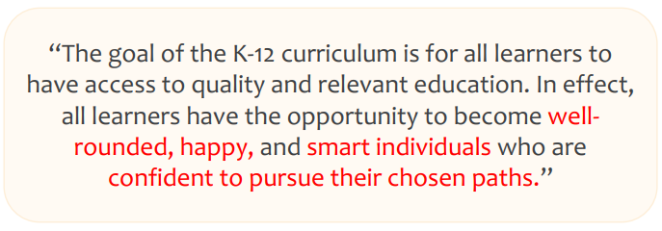

Slide 29
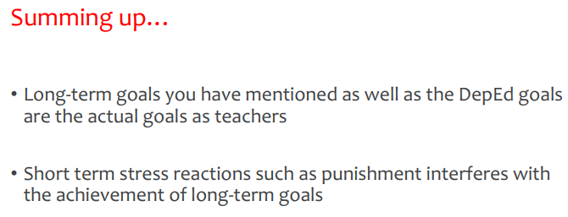

Slide 31
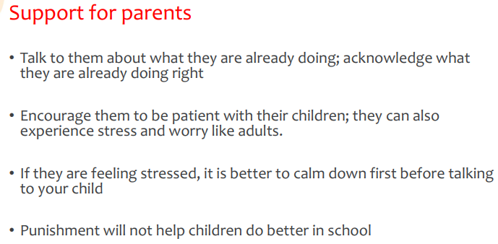

Slide 32
